Slide 1

countByWindow

Slide 2
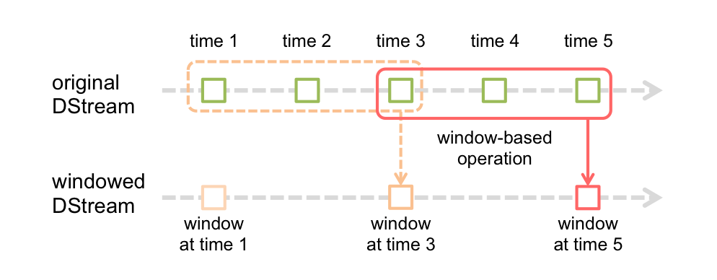
countByWindow() Overview
countByWindow(windowLength, slideInterval)
Return a sliding window count of elements in the stream.

